Slide 1
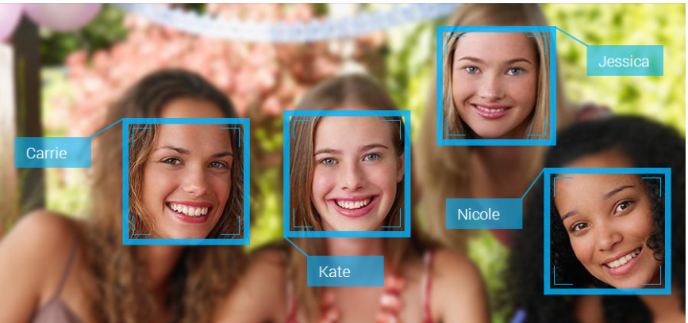

FACIAL RECOGNITION ATTENDANCE SYSTEM BASED ON IOT
TEAM MEMBER:
1 JOGI MALAY
2 YASHPAL DANGAR
3 KISHAN KHADASALIYA
4 ARYAN PARVADIYA
5 RAKSHIT PARMAR

Slide 2

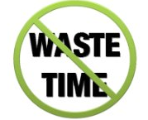
Introduction :
Traditionally attendance is marked manually by teachers and they must make sure correct attendance is marked for respective student.
This whole process wastes some of lecture time and part of correct information is missed due to fraudulent and proxy cases.

Slide 3
Introduction :
In order to determine classroom attendance, face detection and face recognition are performed. Face detection is used to determine the location of the faces in the classroom image and extract sub images for each face. Then, in face recognition, the face images detected will be compared with the data base consisting of images of students in the class, and attendance will be recorded accordingly.

Slide 4
Face Detection:
Face detection is a computer technology used to identify human faces in digital images by determining the location of the faces in the image and extract sub images for each face.

Slide 5
COMPONENT
1. ARDUINO UNO-01
2. BREADBORD
3. HC-SR04 ULTRASONIC SENSOR-01
4. LED

Slide 6
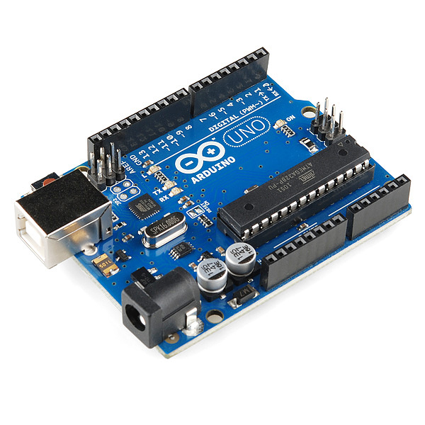
What can it do?
Great for prototyping ideas
Access to multiple I/O
Drive motors, turn on lights, trigger controls.
Low Power requirements
Flexible / Open-source

Slide 7
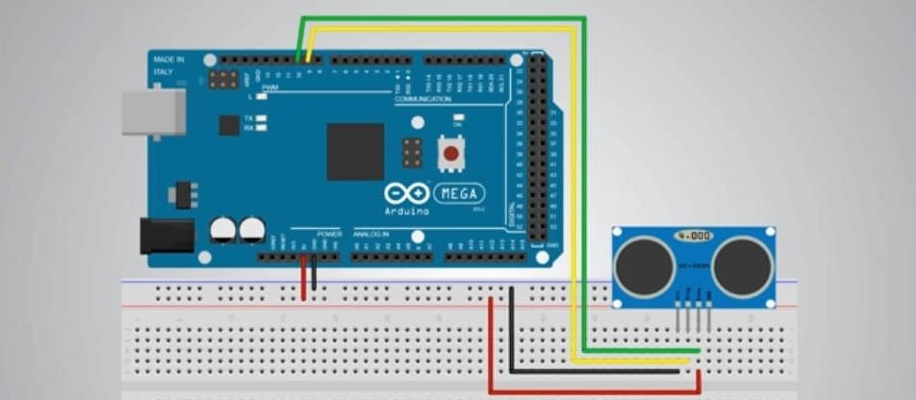
HOW TO IMPLEMENT IT?

Slide 8
SOFTWARE AND PACKAGE
SOFTWARE
1. ARDUINO
2. PYCHARM
3. MYSQL/XAMPP(NOT NECCESARY IF YOU ARE STORING IN CSV FORMATE)
PACKAGES
1. OPEN CV
2. NUMPY
3. FACE_RECOGNITION
4. OS
5. DATE-TIME
6. PYSERIAL

Slide 9
SOFTWARE
1. ARDUINO
USED FOR COMPONENT CONFIGURATION
2.PYCHARM
FOR PYTHON CODE AND IMPLEMENTATION OF CODE
3.MYSQL/XAMPP
FOR DATABASES, NOT IMPORTANT IF YOU WANT A CSV FORMAT

Slide 10
PACKAGES
1.OPEN CV
OpenCV is a cross-platform library using which we can develop real-time computer vision applications. It mainly focuses on image processing, video capture and analysis including features like face detection and object detection.
Computer Vision overlaps significantly with the following fields −
Image Processing − It focuses on image manipulation.
Pattern Recognition − It explains various techniques to classify patterns.
Photogrammetry − It is concerned with obtaining accurate measurements from images.
Image processing deals with image-to-image transformation. The input and output of image processing are both images.
Computer vision is the construction of explicit, meaningful descriptions of physical objects from their image. The output of computer vision is a description or an interpretation of structures in 3D scene.

Slide 11
Features of OpenCV Library
Using OpenCV library, you can −
Read and write images
Capture and save videos
Process images (filter, transform)
Perform feature detection
Detect specific objects such as faces, eyes, cars, in the videos or images.
Analyze the video, i.e., estimate the motion in it, subtract the background, and track objects in it.

Slide 12
FUNCTION OF OPEN CV
CV 2.IMREAD()
Syntax: cv2.imread(path, flag)
Parameters: path: A string representing the path of the image to be read. flag: It specifies the way in which image should be read. It’s default value is cv2.IMREAD_COLOR
Return Value: This method returns an image that is loaded from the specified file.

Slide 13
FUNCTION OF OPEN CV
Cv2.cvtColor()
Syntax: cv2.cvtColor(src, code[, dst[, dstCn]])
Parameters: src: It is the image whose color space is to be changed. code: It is the color space conversion code. dst: It is the output image of the same size and depth as src image. It is an optional parameter. dstCn: It is the number of channels in the destination image. If the parameter is 0 then the number of the channels is derived automatically from src and code. It is an optional parameter.
Return Value: It returns an image.

Slide 14
FUNCTION OF OPEN CV
Cv2.resize()
cv2.INTER_AREA: This is used when we need to shrink an image.
cv2.INTER_CUBIC: This is slow but more efficient.
cv2.INTER_LINEAR: This is primarily used when zooming is required. This is the default interpolation technique in OpenCV.
cv2.resize(src, dsize[, dst[, fx[, fy[, interpolation]]]])

Slide 15
FUNCTION OF OPEN CV
Cv2.rectangle()
Syntax: cv2.rectangle(image, start_point, end_point, color, thickness)
Parameters: image: It is the image on which rectangle is to be drawn. start_point: It is the starting coordinates of rectangle. The coordinates are represented as tuples of two values i.e. (X coordinate value, Y coordinate value). end_point: It is the ending coordinates of rectangle. The coordinates are represented as tuples of two values i.e. (X coordinate value, Y coordinate value). color: It is the color of border line of rectangle to be drawn. For BGR, we pass a tuple. eg: (255, 0, 0) for blue color. thickness: It is the thickness of the rectangle border line in px. Thickness of -1 px will fill the rectangle shape by the specified color.
Return Value: It returns an image.

Slide 16
FUNCTION OF OPEN CV
Cv2.puttext()
Syntax: cv2.putText(image, text, org, font, fontScale, color[, thickness[, lineType[, bottomLeftOrigin]]])
Parameters: image: It is the image on which text is to be drawn. text: Text string to be drawn. org: It is the coordinates of the bottom-left corner of the text string in the image. The coordinates are represented as tuples of two values i.e. (X coordinate value, Y coordinate value). font: It denotes the font type. Some of font types are FONT_HERSHEY_SIMPLEX, FONT_HERSHEY_PLAIN, , etc. fontScale: Font scale factor that is multiplied by the font-specific base size. color: It is the color of text string to be drawn. For BGR, we pass a tuple. eg: (255, 0, 0) for blue color. thickness: It is the thickness of the line in px. lineType: This is an optional parameter.It gives the type of the line to be used. bottomLeftOrigin: This is an optional parameter. When it is true, the image data origin is at the bottom-left corner. Otherwise, it is at the top-left corner.
Return Value: It returns an image.

Slide 17
FUNCTION OF OPEN CV
1. cv2.imshow()
Syntax: cv2.imshow(window_name, image) Parameters: window_name: A string representing the name of the window in which image to be displayed. image: It is the image that is to be displayed. Return Value: It doesn’t returns anything.
2. cv2.waitkey()
waitkey() function of Python OpenCV allows users to display a window for given milliseconds or until any key is pressed. It takes time in milliseconds as a parameter and waits for the given time to destroy the window, if 0 is passed in the argument it waits till any key is pressed.

Slide 18
DEPENDENCY FACE RECOGNITION
1. DLIB
2. PILLOW
3. CMAKE

Slide 19
dLIB
The dlib library provides two functions that can be used for face detection:
HOG + Linear SVM: dlib.get_frontal_face_detector()
MMOD CNN: dlib.cnn_face_detection_model_v1(modelPath)
The
get_frontal_face_detector
function does not accept any parameters. A call to it returns the pre-trained HOG + Linear SVM face detector included in the dlib library.
Dlib’s HOG + Linear SVM face detector is fast and efficient. By nature of how the Histogram of Oriented Gradients (HOG) descriptor works, it is not invariant to changes in rotation and viewing angle.
For more robust face detection, you can use the MMOD CNN face detector, available via the
cnn_face_detection_model_v1
function. This method accepts a single parameter, modelPath
, which is the path to the pre-trained mmod_human_face_detector.dat
file residing on disk.

Slide 20
PILLOW
Python Pillow module is built on top of PIL (Python Image Library). It is the essential modules for image processing in Python. But it is not supported by Python 3. But, we can use this module with the Python 3.x versions as PIL. It supports the variability of images such as jpeg, png, bmp, gif, ppm, and tiff.
We can do anything on the digital images using the pillow module. In the upcoming section, we will learn various operations on the images such as filtering images, Creating thumbnail, merging images, cropping images, blur an image, resizing an image, creating a water mark and many other operations.

Slide 21
CMAKE
CMake is used to control the software compilation process using simple platform and compiler independent configuration files, and generate native makefiles and workspaces that can be used in the compiler environment of your choice.
The suite of CMake tools were created by Kitware in response to the need for a powerful, cross-platform build environment for open-source projects such as ITK and VTK.

Slide 22
FUNCTIONS OF FACE_RECOGNITION
face_recognition.face_encodings(img)[0]
It will provide you with list of arrays which will provide you the face encodings
Parameters:
Img -- image

Slide 23
Function of Face recognition
Face_recognition.face_locations
It will provide you with the face locations
It will returns four co-ordinates : x1,y2,x2,y1

Slide 24
Functions of face_recognition:
Face_recognition.compare_faces()
It will take two parameters that both are faces

Slide 25
Connections:
Connect vcc pin of ultrasonic sensor to 5v of Arduino
Connect trig pin to 8
Connect echo pin to 9
Connect led with 13 and gnd

Slide 26
How it will work?
The ultrasonic sensor will detect if the door is near 10 cm or not(i.e. door is closed)
If its not near 10 cm(i.e. door is open) the camera will open and will do face_recognition and the attendance will be stored in database
And when it is closed we could see in the database that our entry has been done

Slide 27
Thank you

